Slide 1

Reference dependence
Notes on Behavioural Economics
Jason Collins

Slide 2
You have not checked your share portfolio in a while. You expect it is worth around $40,000. Today when you check, it is worth $30,000. Do you feel rich or poor?

Slide 3
You have not checked your share portfolio in a while. You expect it is worth around $20,000. Today when you check, it is worth $30,000. Do you feel rich or poor?

Slide 4

$$U(\$30,000)$$

Slide 5
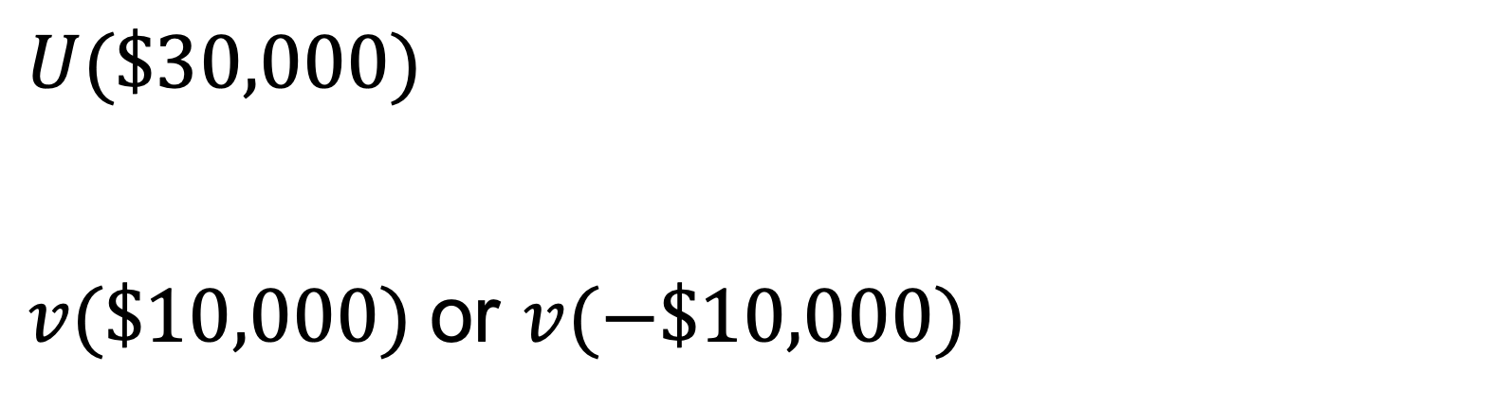
$$U(\$30,000)$$
$v(\$10,000)$or $v(−\$10,000)$

Slide 6
Reference dependence
The status quo
Lagged consumption
Goals
Recent expectations

Slide 7
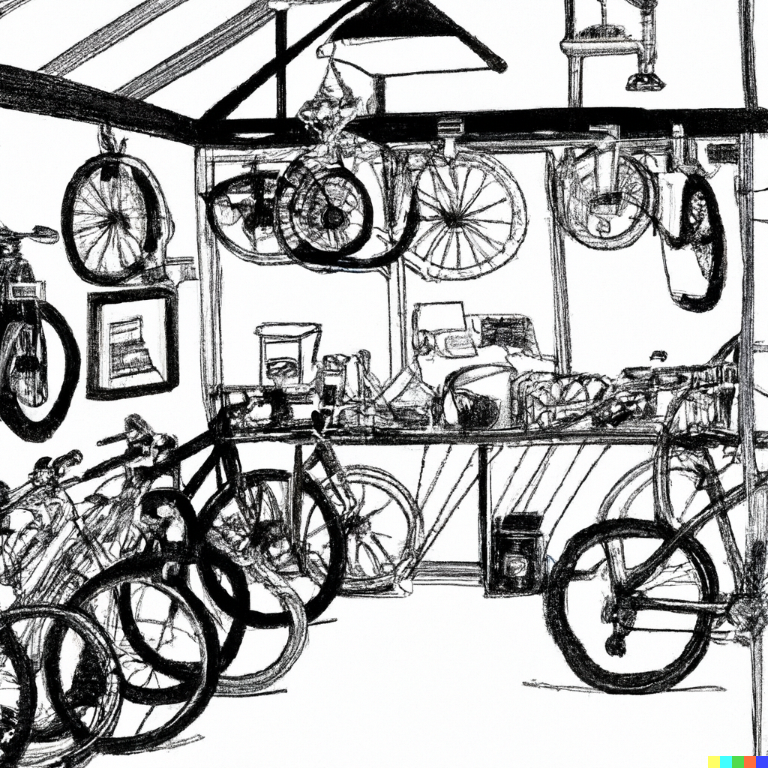

Slide 8


Slide 9
Sally and Trish both follow workout plans that usually involve doing 25 sit-ups.
One day, Sally sets a goal of performing 31 sit-ups. She finds herself very tired after performing 35 sit-ups and stops.
Trish sets a goal of performing 39 sit-ups. She finds herself very tired after performing 35 sit-ups and stops.

